Slide 1
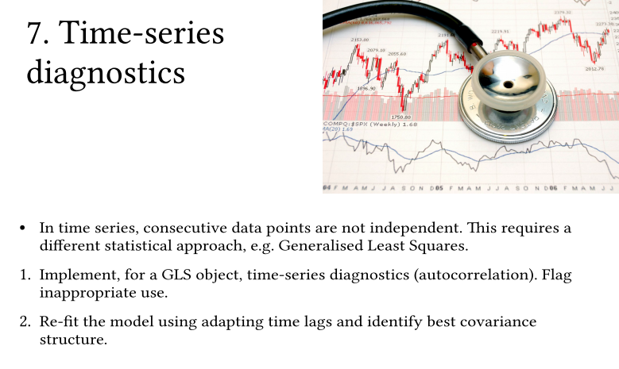
P

Slide 2
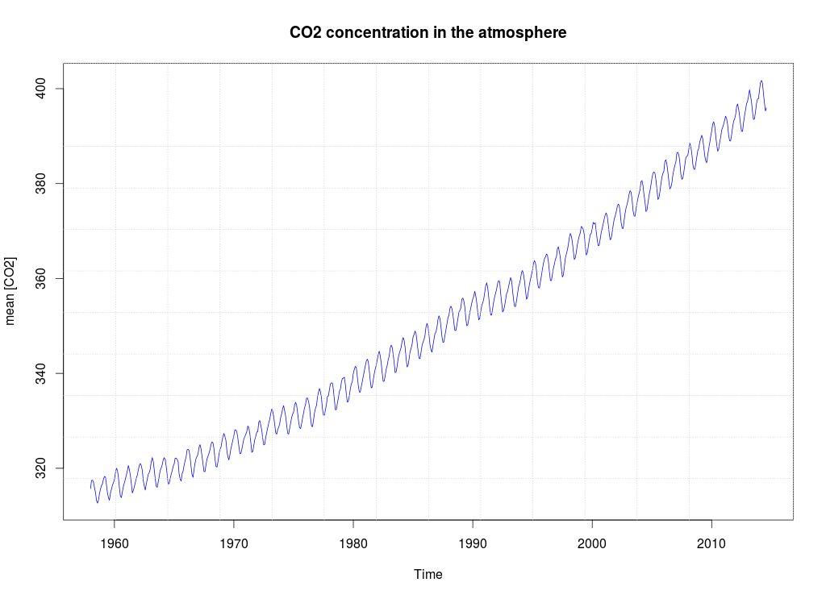
Global CO2 concentrations from 1958 - 2014
P
© M.Cordes, E.Rosskopf, J. Lumiko

Slide 3
Analysing the structure of the time series
Stationarity? (adf.test / pp.test / kpss.test)
Trend? (decompose / aggregate)
Cycle? (decompose)
Autocorrelation? (acf, pacf, spectrum)
Model fitting
Adequately model fit that represents the time series best (unbiased p values)
Forecasting
Using fitted GLS/ARIMA/ HoltWinters
Procedure
P
© M.Cordes, E.Rosskopf, J. Lumiko

Slide 4
Time Series
CO2 - time series
Non-stationary
Stationary
(Stochastic)
Deterministic
(Stochastic)
Deterministic
Differentiate
Decompose
detrend
deseason
and the random?
Check for Autocorrelation
if true, fit it for modelling
Fit a Model
GLS
ARIMA
auto-ARIMA
...
4. Choose the best model
AIC
Forecasting
P

Slide 5
Open Questions
The CO2 - time series is deterministic (dependencies between values). How about stochastic time series? (random, more unpredictable) Further steps in analysis to take?
The CO2 -dataset decomposition allows us to extract a trend, a seasonal component as well as a random component. Is it important to consider the random component in a gls although it is constant throughout the time series?
P

Slide 6
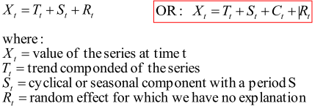
Decomposition of Time-Series
A time series can be decomposed into its components:
Trend
Cycles (including seasonal)
Irregular components (random):
P

Slide 7
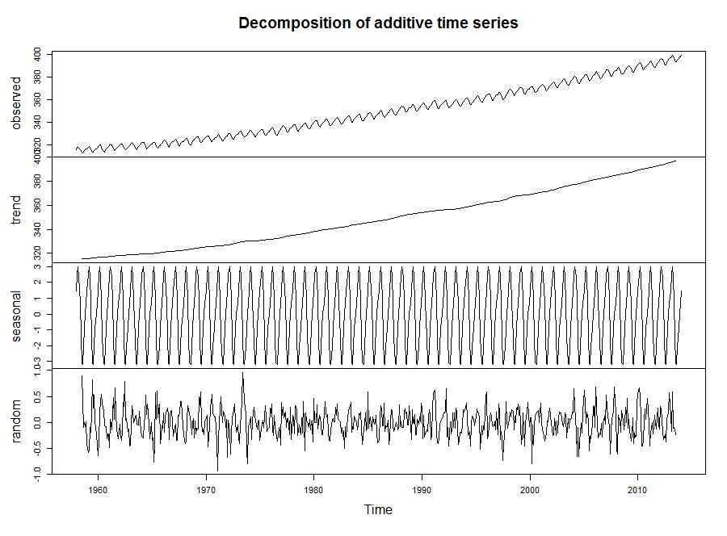
P
decompose(timeseries)
© M.Cordes, E.Rosskopf, J. Lumiko

Slide 8
Definition:
A time series is a sequence of observations which are ordered in time (or space)
Data are observed at equally spaced time intervals
Notation: X t is the measurement of variable X at time t
X t can be continuous or discrete (counts)

Slide 9
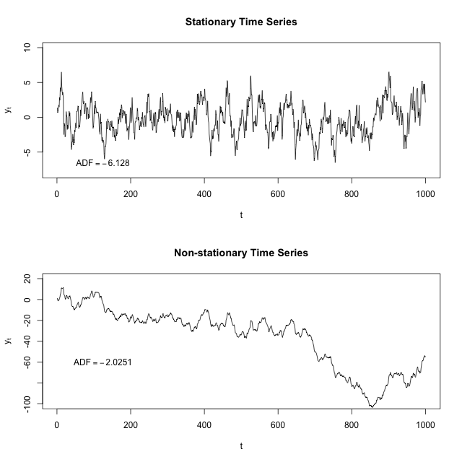
Types of time series:
stationary
A stationary time series is one whose statistical properties (e.g. mean, variance, autocorrelation, etc.) are all constant over time → is simple to predict!
non stationary
© M.Cordes, E.Rosskopf, J. Lumiko

Slide 10
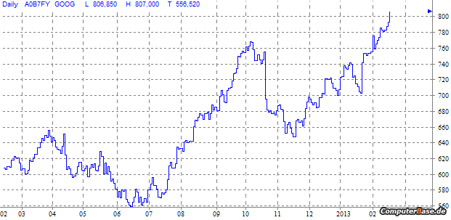
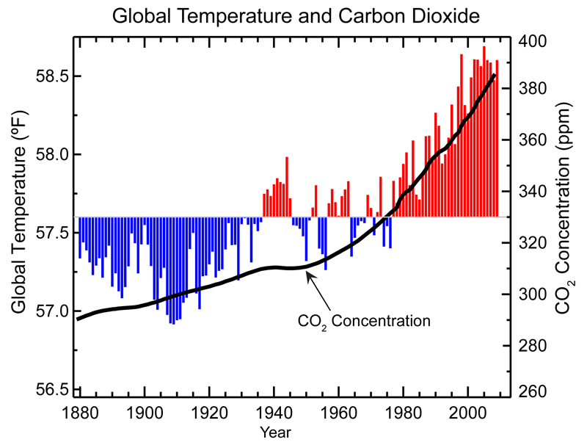
Trends
stochastic
deterministic
e.g. weekly share prices, monthly profits
e.g. daily rainfall, wind speed, temperature
P

Slide 11
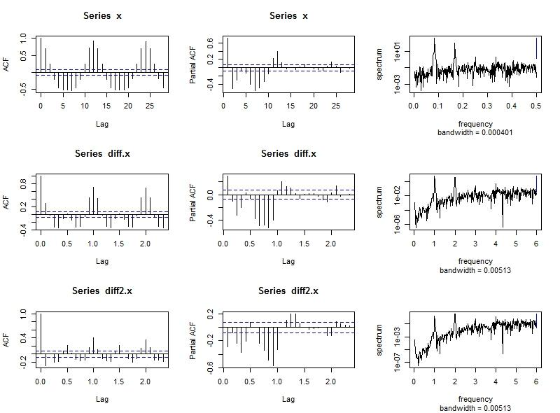
Differencing
© M.Cordes, E.Rosskopf, J. Lumiko

Slide 12
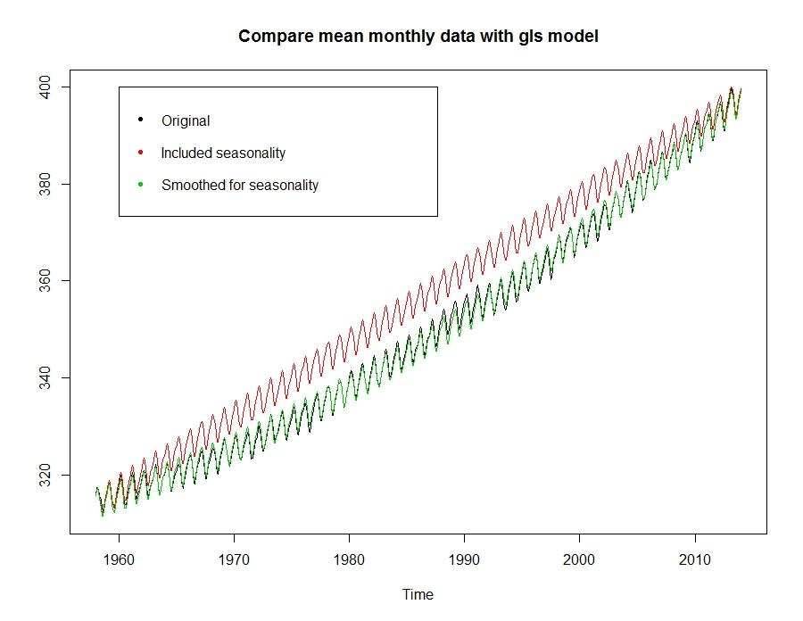
P
© M.Cordes, E.Rosskopf, J. Lumiko

Slide 13
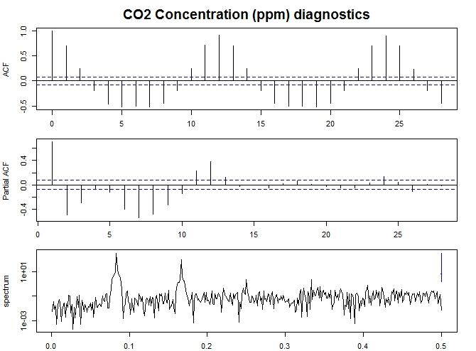
Diagnostics
Autocorrelation
(acf, pacf,spectrum)
Differentiation (diff)
Rerunning the Auto-correlation (better fit ?)
P
© M.Cordes, E.Rosskopf, J. Lumiko

Slide 14
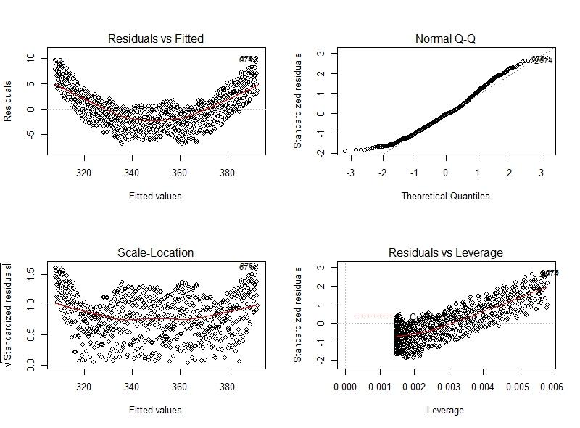
GLS (Generalized Least Squares)
important to specify a form of spatial correlation structure: several options, choose wisely
if no clue: run all and compare the AIC of each gls
choose that gls + corStruct with smallest AIC
AIC = Akaike Information Criterion
P
© M.Cordes, E.Rosskopf, J. Lumiko

Slide 15
Manual GLS-Fit
data.gls = gls(co2 ~ year,cor= corAR1(acf(resid(data.lm))$acf[2])) #use lag one data.acf[2]))
dataseason.gls = gls(ts.x ~ time + factor(seas),cor= corAR1(acf(resid(data.lm))$acf[2])) #use lag one data.acf[2]
smoothed.gls = gls(ts.x~ time.norm + I(time.norm^2) +
COS[,1]+SIN[,1]+COS[,2]+SIN[,2]+
COS[,3]+SIN[,3]+COS[,4]+SIN[,4]+
COS[,5]+SIN[,5]+COS[,6]+SIN[,6], corr=corAR1(acf(resid(data.lm))$acf[2]))
check AIC for all of them, test for autocorrelation
AIC lowest for smoothed.gls, Durbin Watson test not sign.
© M.Cordes, E.Rosskopf, J. Lumiko

Slide 16
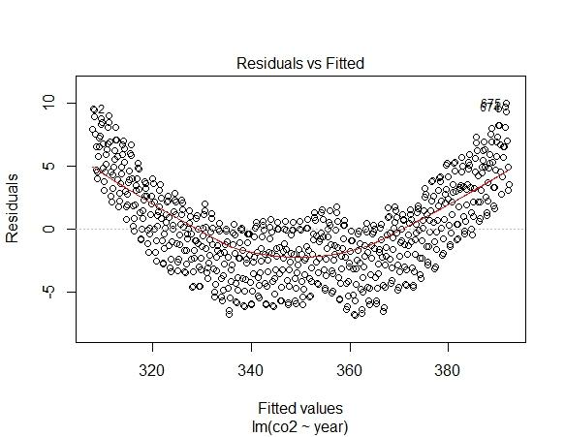
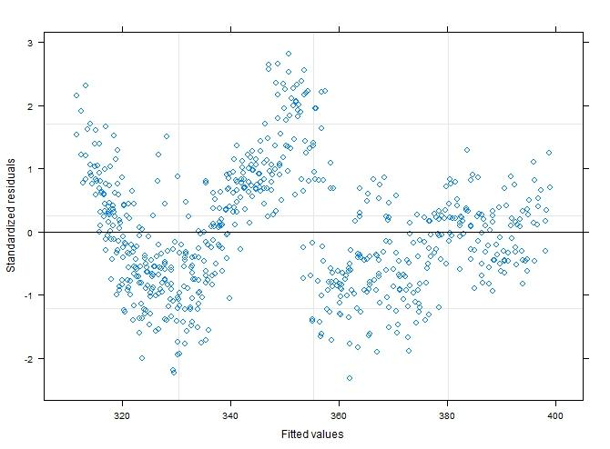
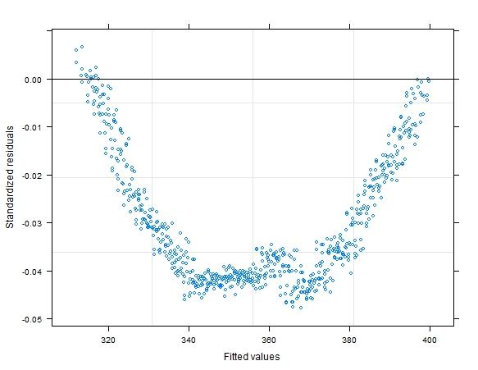
steady
improvements
of resid. spread
© M.Cordes, E.Rosskopf, J. Lumiko

Slide 17
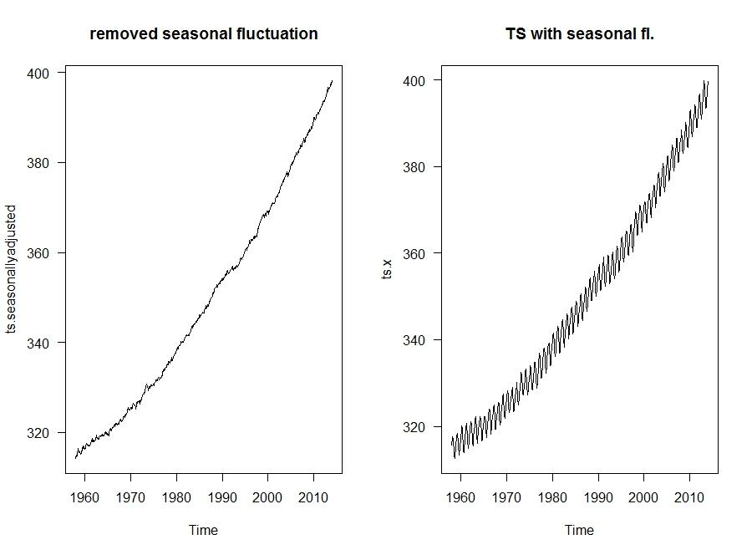
Other options to model time series
remove seasonal fluctuations with the decomposition function decompose()
Find adequate ARIMA
(auto.arima)
© M.Cordes, E.Rosskopf, J. Lumiko

Slide 18
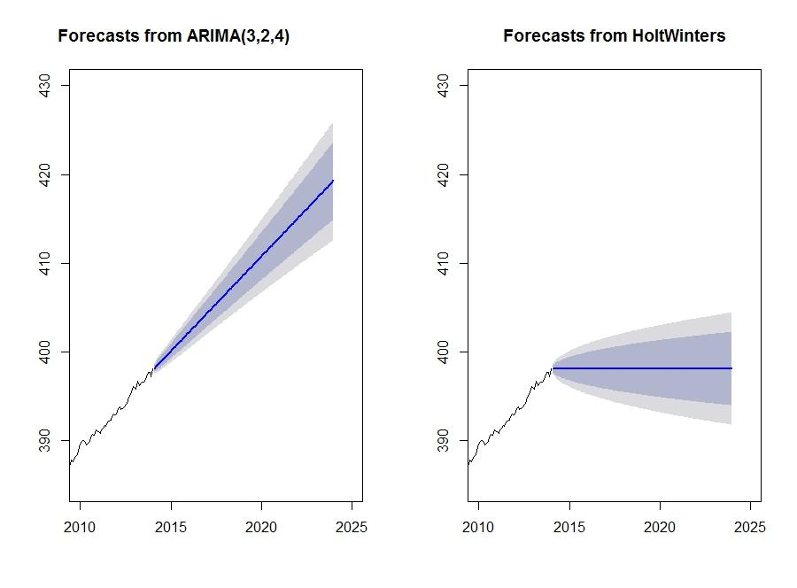
Predictions
© M.Cordes, E.Rosskopf, J. Lumiko

